Slide 1


Predictive Global Climate Modeling Using Teleconnection Patterns
By Tyson Stewart, Landon Moeller, Owen Cutinello, and Matthew Woods
Everstream Liaison: Mr. Logan Bundy

Slide 2
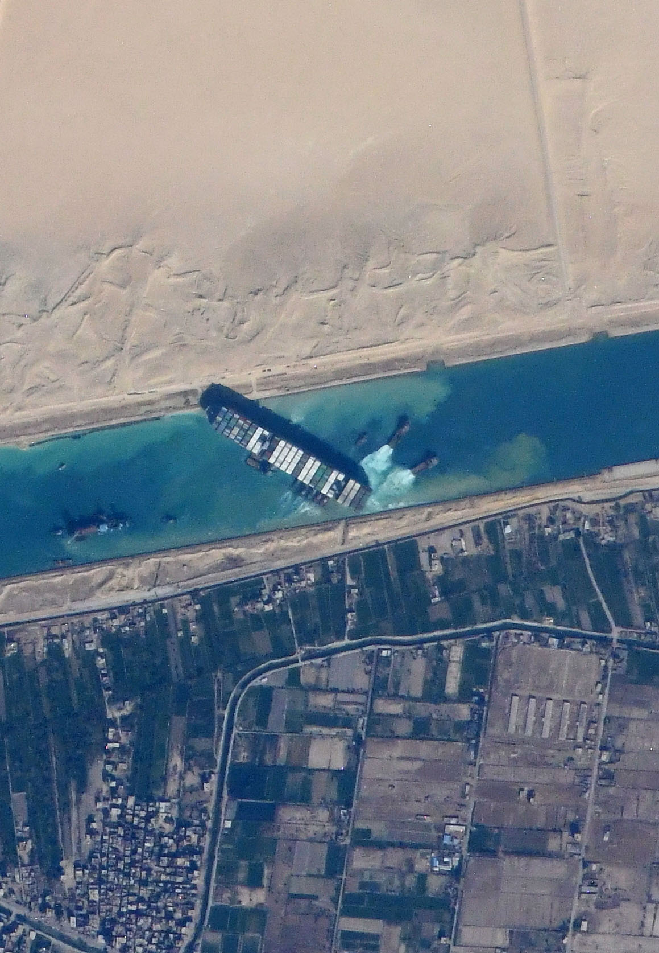
Background
Supply chain operations are increasingly interconnected
One event can quickly cascade into side effects seen months after
Decisions often need to be made well in advance of potential hazards
A vital need exists for reliable, long-term forecasting to aid supply chain risk assessment and decision-making
Such long-term forecasts present several challenges however
Photo from the ISS of the container ship Ever Given stuck in the Suez Canal. (Photo courtesy of NASA Johnson Space Center; ISS064-E-48480)

Slide 3
Long-Term Forecasting Challenges
Limitations of Numerical Weather Models
Most common weather models work in the 1-10 day range
Longer time scale models exist but come with their own caveats
Longer forecast period = Less accuracy
Different regions present drastically different seasonal conditions due to geography
Winter in Michigan is different from winter in Australia
Climate Change adds another element of variability
Potential changes to climate systems like monsoons
Further complicates risk assessment

Slide 4
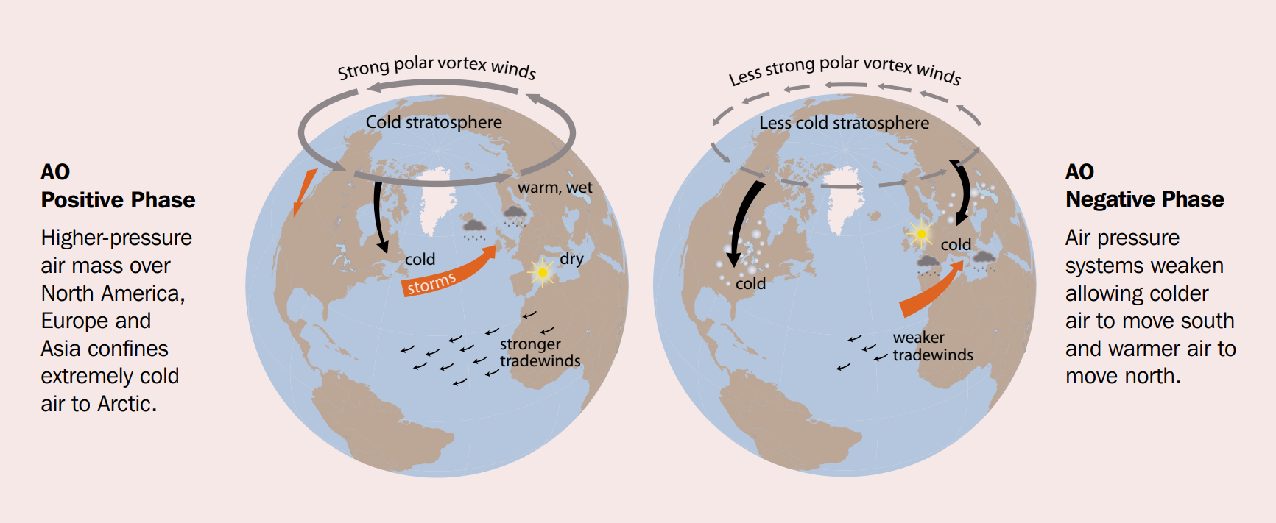
Teleconnections
AMAP, 2012. Arctic Climate Issues 2011: Changes in Arctic Snow, Water, Ice and Permafrost. SWIPA 2011 Overview Report. Arctic Monitoring and Assessment Programme (AMAP), Oslo. xi + 97pp

Slide 5
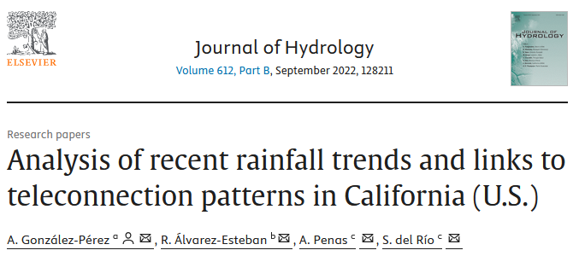
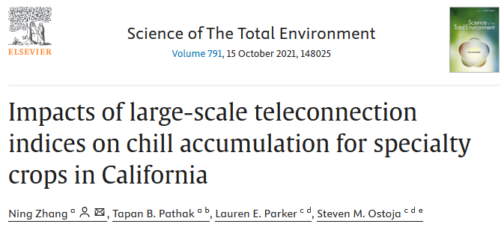
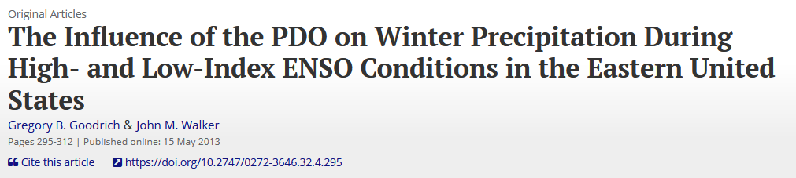
Teleconnections
Teleconnections can be very useful for regional long-term/climate forecasting
Phases corresponding to different predominant atmospheric patterns

Slide 6
Teleconnections
However, teleconnection indices only measure one particular pattern/oscillation
Multiple teleconnection patterns are needed to be analyzed at the same time to assess risk
Additionally, teleconnection pattern effects are regionalized
One teleconnection may be good at predicting one area, but struggle with another.
In certain instances, teleconnection indices can conflict with one another
Raises questions of how to “break the tie” to make a decision

Slide 7
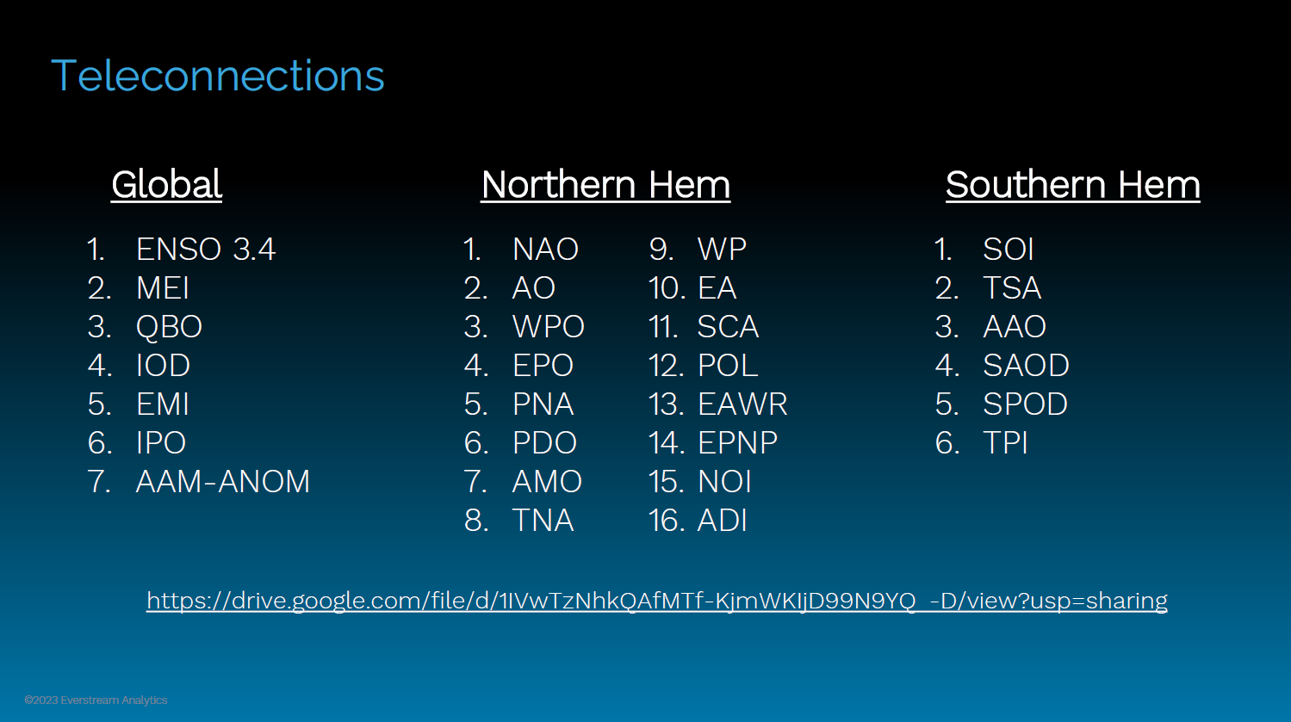

Slide 8
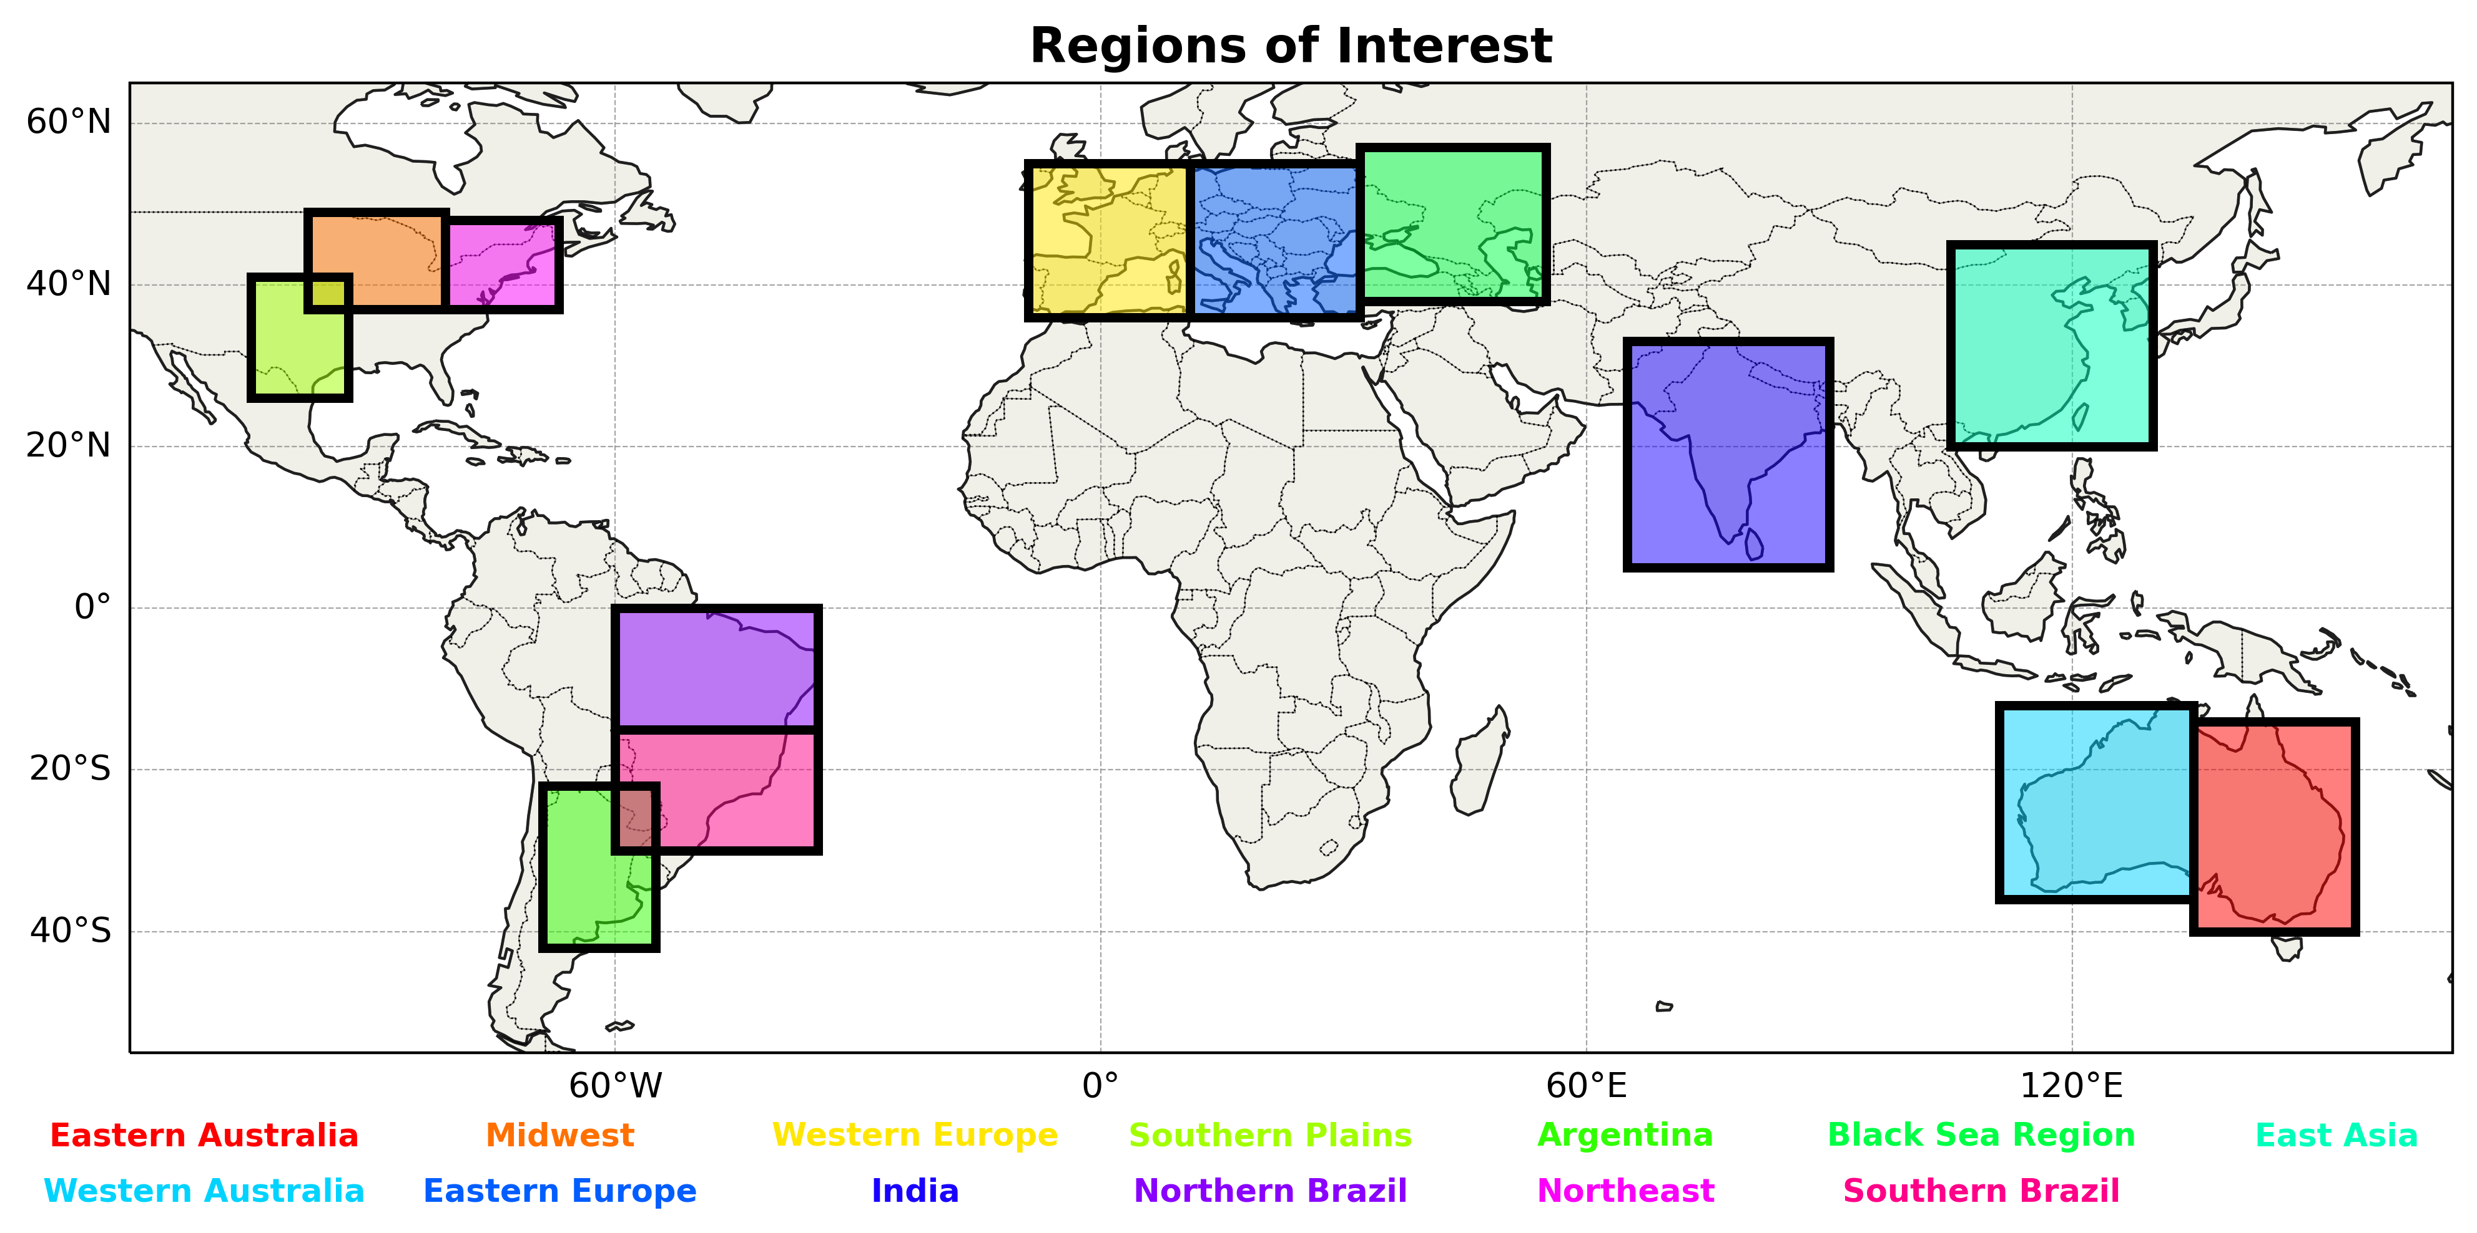

Slide 9
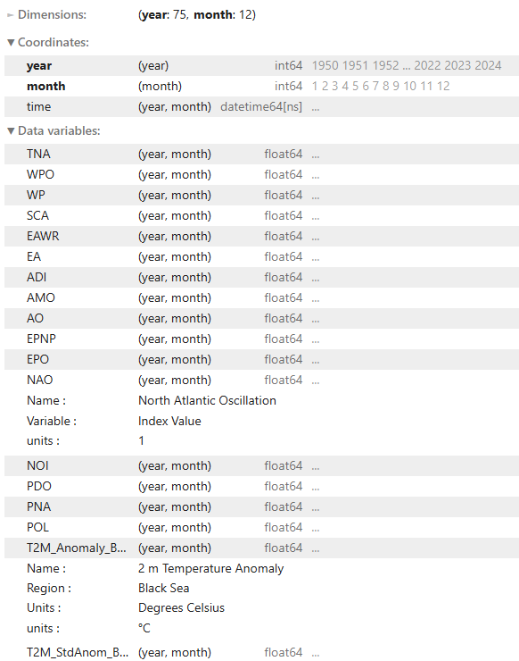


Data Sources
Teleconnection Data (1950-2024)
Monthly Index Value
NOAA, Climate Prediction Center
Climate Anomaly Data (1950-2024)
Monthly Temp and Precip Anomalies
ECMWF Reanalysis v5 (ERA5)
Baseline period (1980-2010)

Slide 10
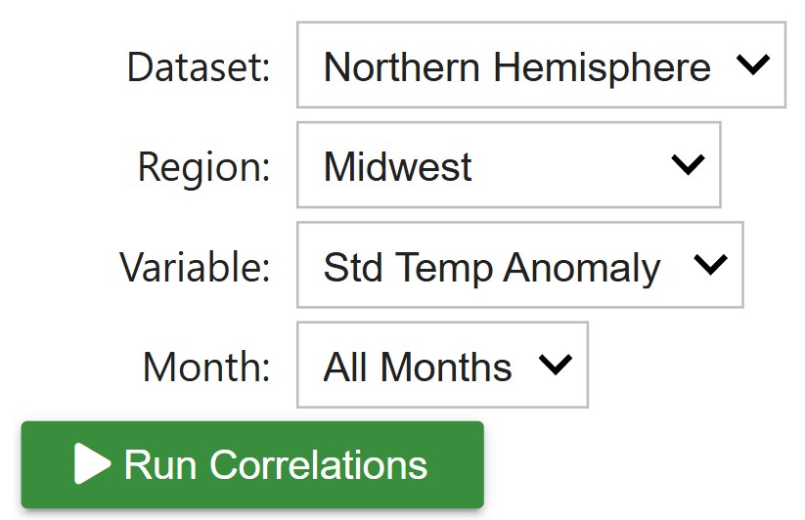
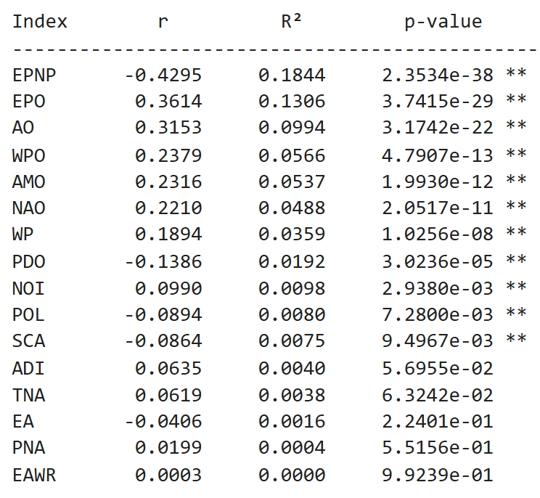
Methods
INFORM a statistical model
Calculate Pearson correlation strength and sign (r)
Determine statistical significance (p-value < 0.05)
Run this for all 13 regions, both variables, all months, and individual months
Use correlations strength to identify preferred model input

Slide 11
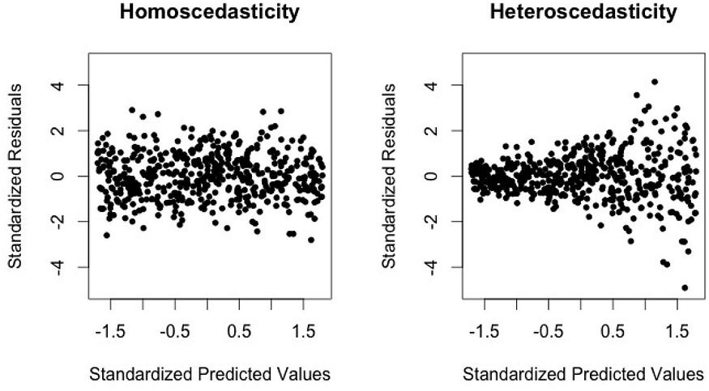
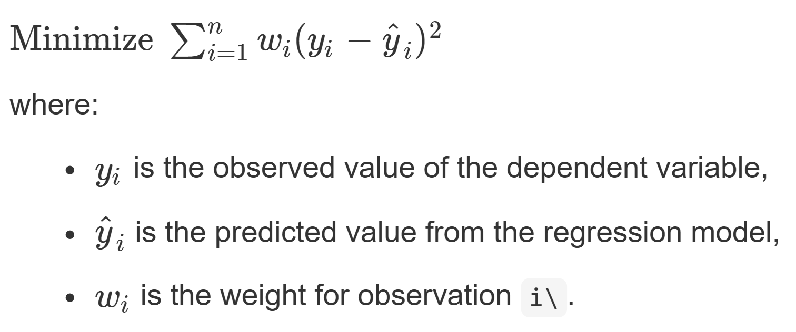
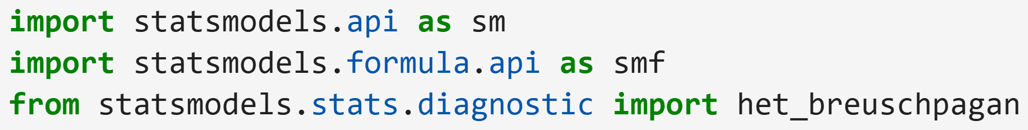

Methods
Reid and Allum 2019
BUILD a statistical model
“statsmodels” package in Python
Multiple linear regression with least squares (OLS or WLS)
Allows us to account for the presence of non-homogenous variance
Test for heteroscedasticity
Use the Breusch-Pagan test (Breusch and Pagan 1979)
Amazon AWS
https://www.statsmodels.org/stable/index.html

Slide 12
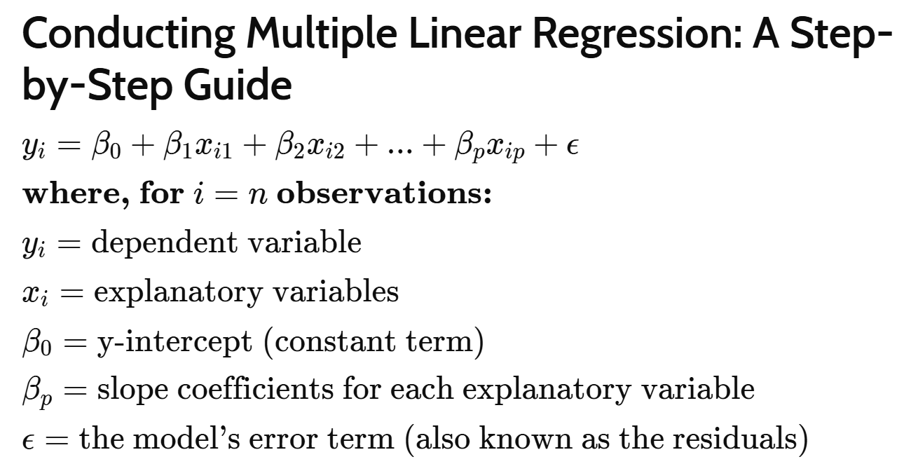
Methods
Investopedia
APPLY a statistical model
Break up by:
Region
Variable
Month
Independent Variables (Predictors):
Teleconnection indices
Only the strongest
Weighted (inverse of variance)
Dependent Variables (Predictands):
Climate anomalies
Temperature – 12 models
Precipitation – 12 models
use to determine supply chain risk

Slide 13
Preliminary Results
Temperature
Strongest Correlation for All Months
Precipitation
Strongest Correlation for All Months
Region | Relevant Hemisphere | Global
Eastern EU | EA: 0.5020 | ENSO: 0.1056
Western EU | EA: 0.4725 | ENSO: 0.1268
Black Sea Region | EAWR: -0.4722 | EMI: -0.0892
Midwest US | EPNP: -0.4295 | EMI: -0.1460
Northeast US | EPNP: -0.3512 | EMI: -0.1754
East Asia | EA: 0.3384 | EMI: -0.1230
Southern Brazil | TSA: 0.2680 | ENSO: 0.2365
Southern Plains US | EPNP: -0.2673 | IPO: -0.1857
Northern Brazil | TSA: 0.2470 | ENSO: 0.2975
Western AU | SOI: -0.1981 | ENSO: 0.2375
India | PDO: 0.1790 | ENSO: 0.1982
Eastern AU | TSA: 0.1525 | ENSO: 0.2192
Argentina | TPI: 0.1355 | IPO: -0.0442
Region | Relevant Hemisphere | Global
Eastern AU | SOI: 0.4485 | ENSO: -0.2743
Eastern EU | AO: -0.3752 | IPO: 0.0498
Western AU | SOI: 0.3276 | ENSO: -0.2126
Western EU | AO: -0.3059 | IPO: 0.1281
Black Sea Region | EAWR: 0.2732 | AAM: 0.1918
Southern Brazil | SPOD: 0.2461 | IPO: 0.2291
East Asia | AMO: -0.2452 | MEI: 0.1321
Argentina | SPOD: 0.2116 | IPO: 0.2207
Midwest US | PNA: -0.1920 | MEI: 0.0999
Southern Plains US | PDO: 0.1870 | MEI: 0.1984
India | PDO: -0.1318 | MEI: -0.1268
Northeast US | EPNP: 0.0636 | IOD: 0.0368
Northern Brazil | SPOD: 0.0610 | AAM: 0.1151

Slide 14
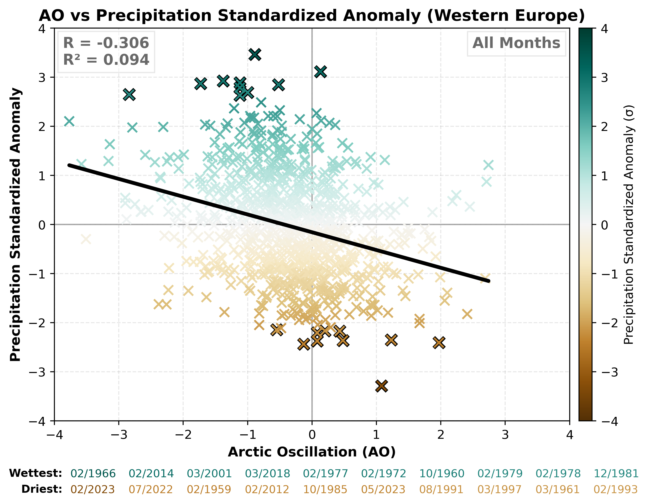

Slide 15
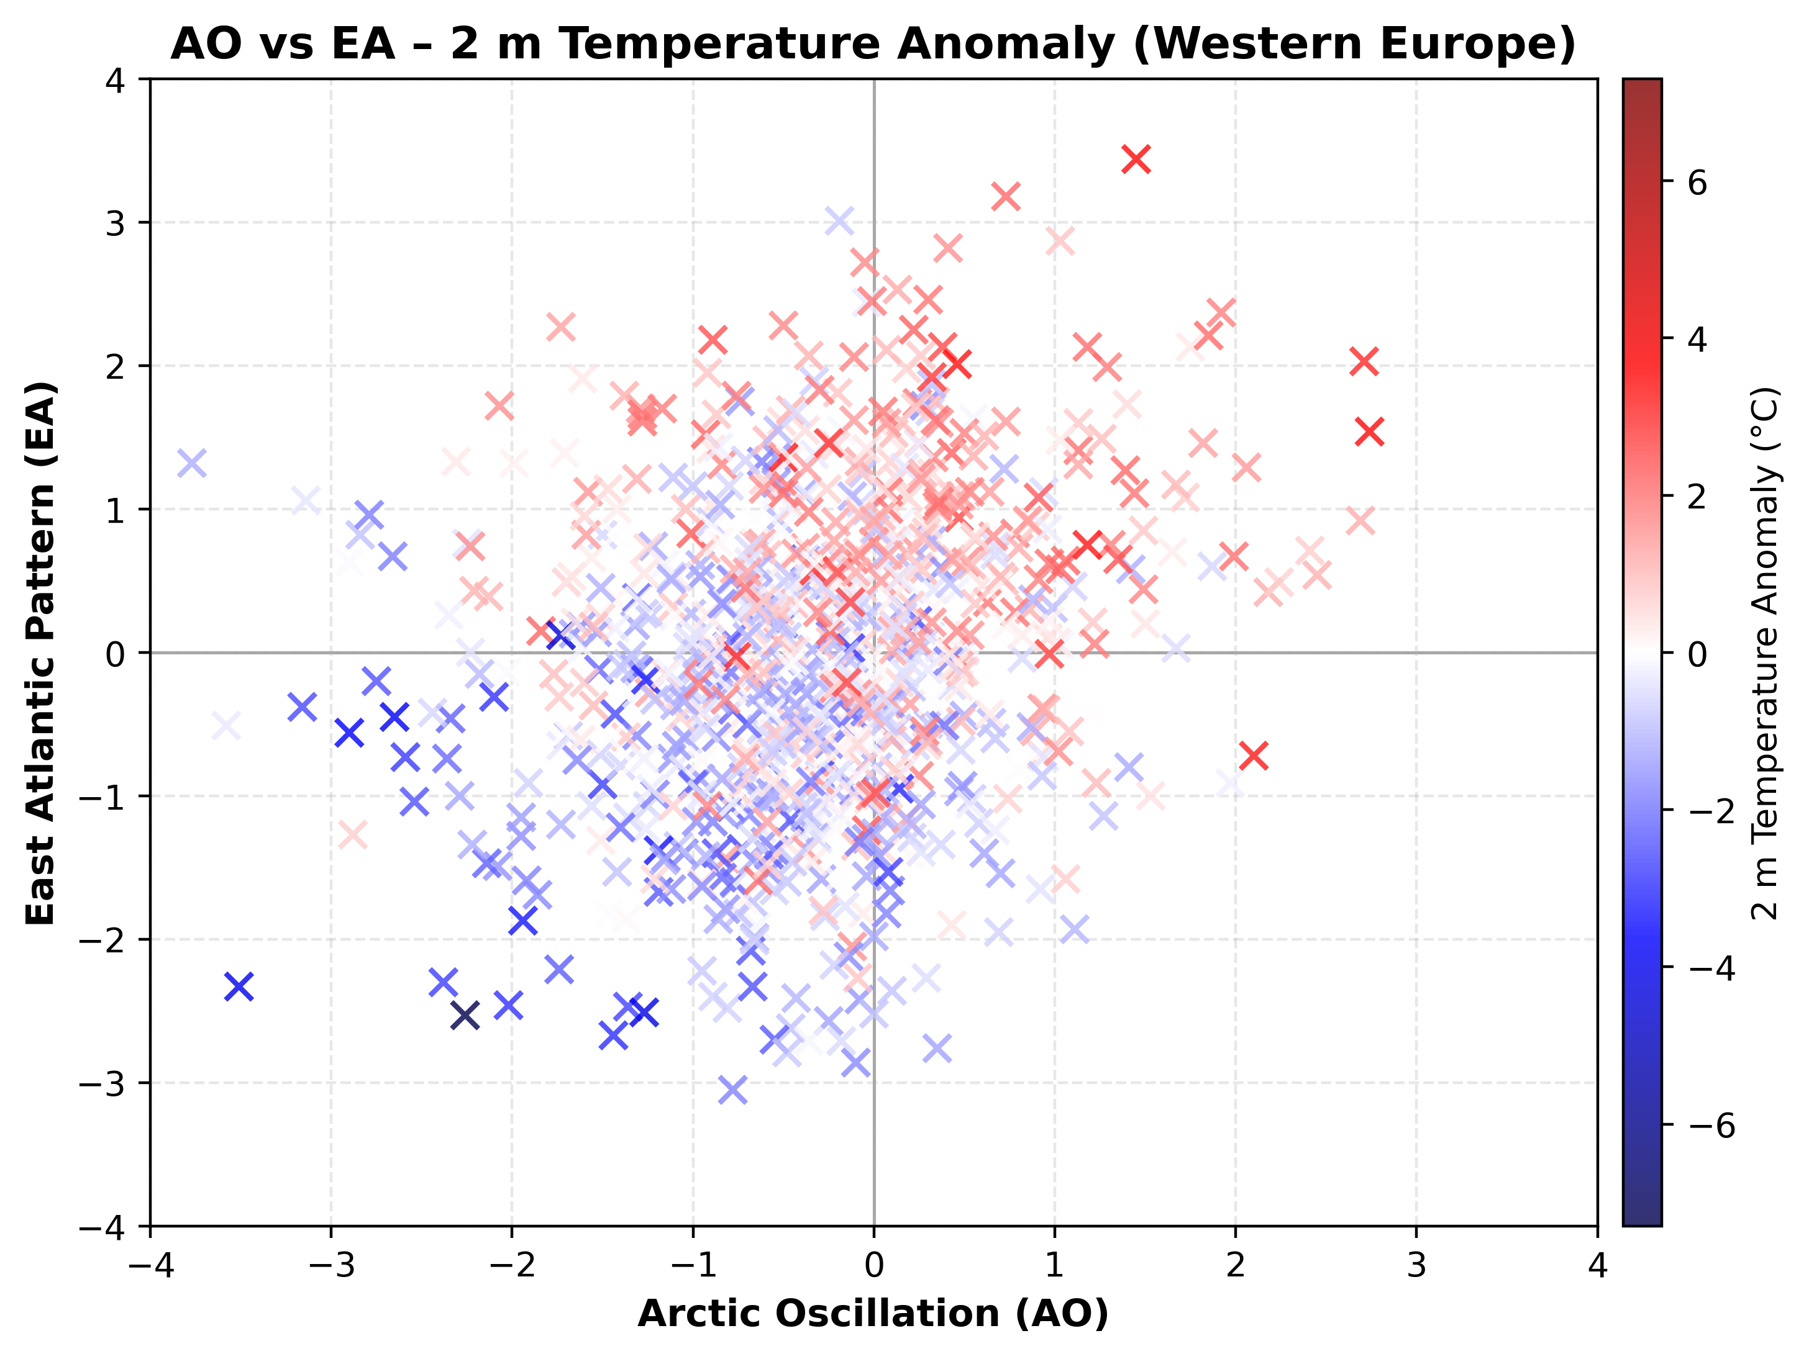

Slide 16
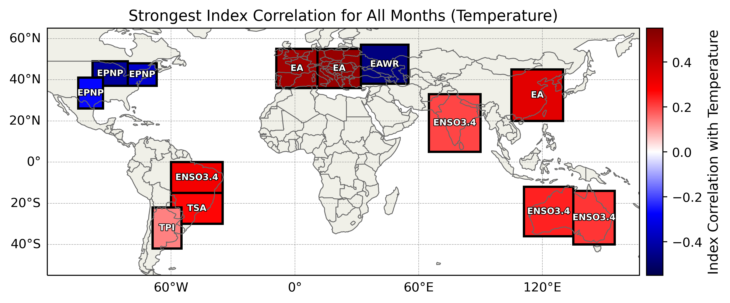
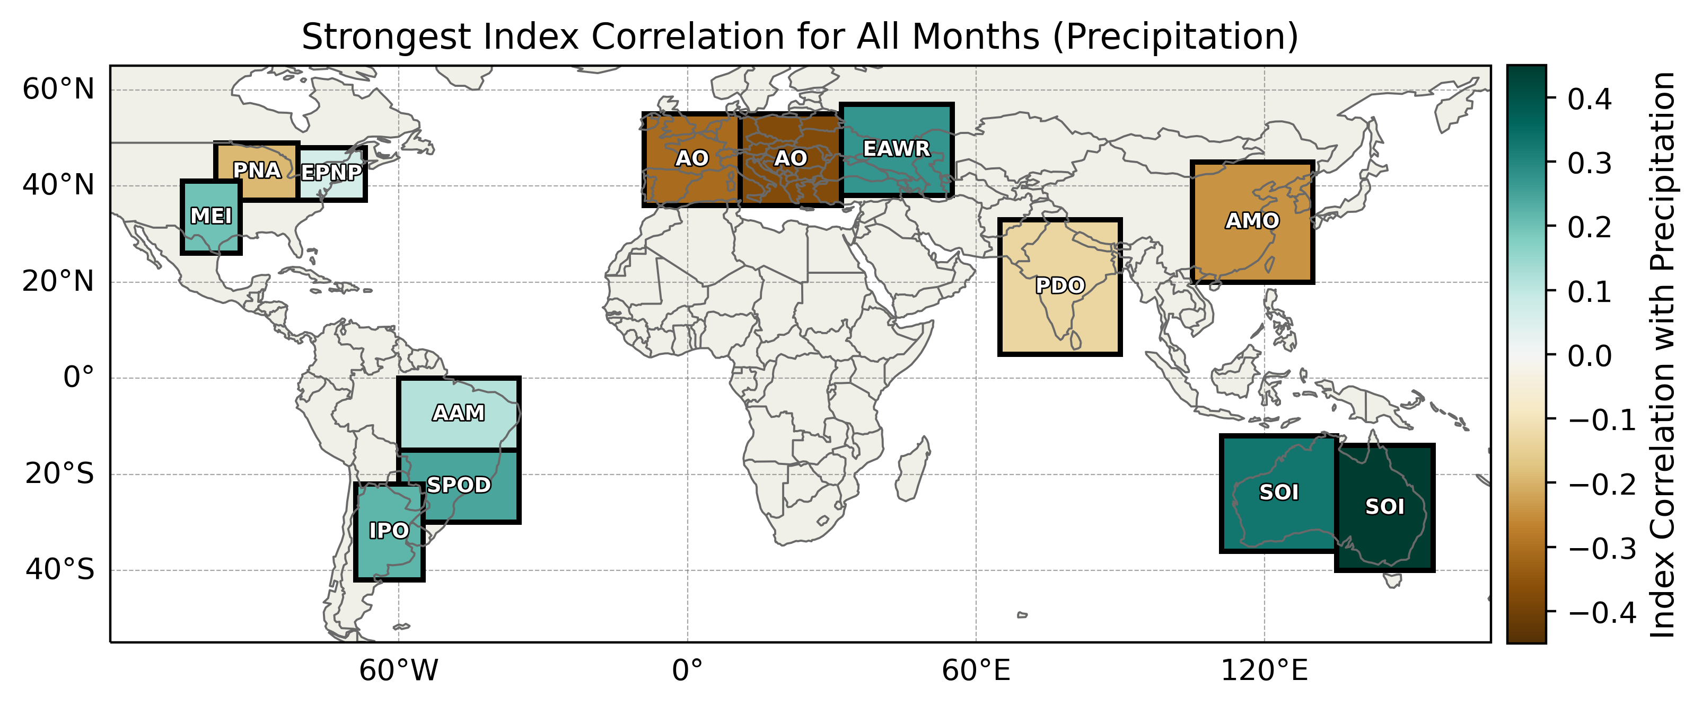

Slide 17
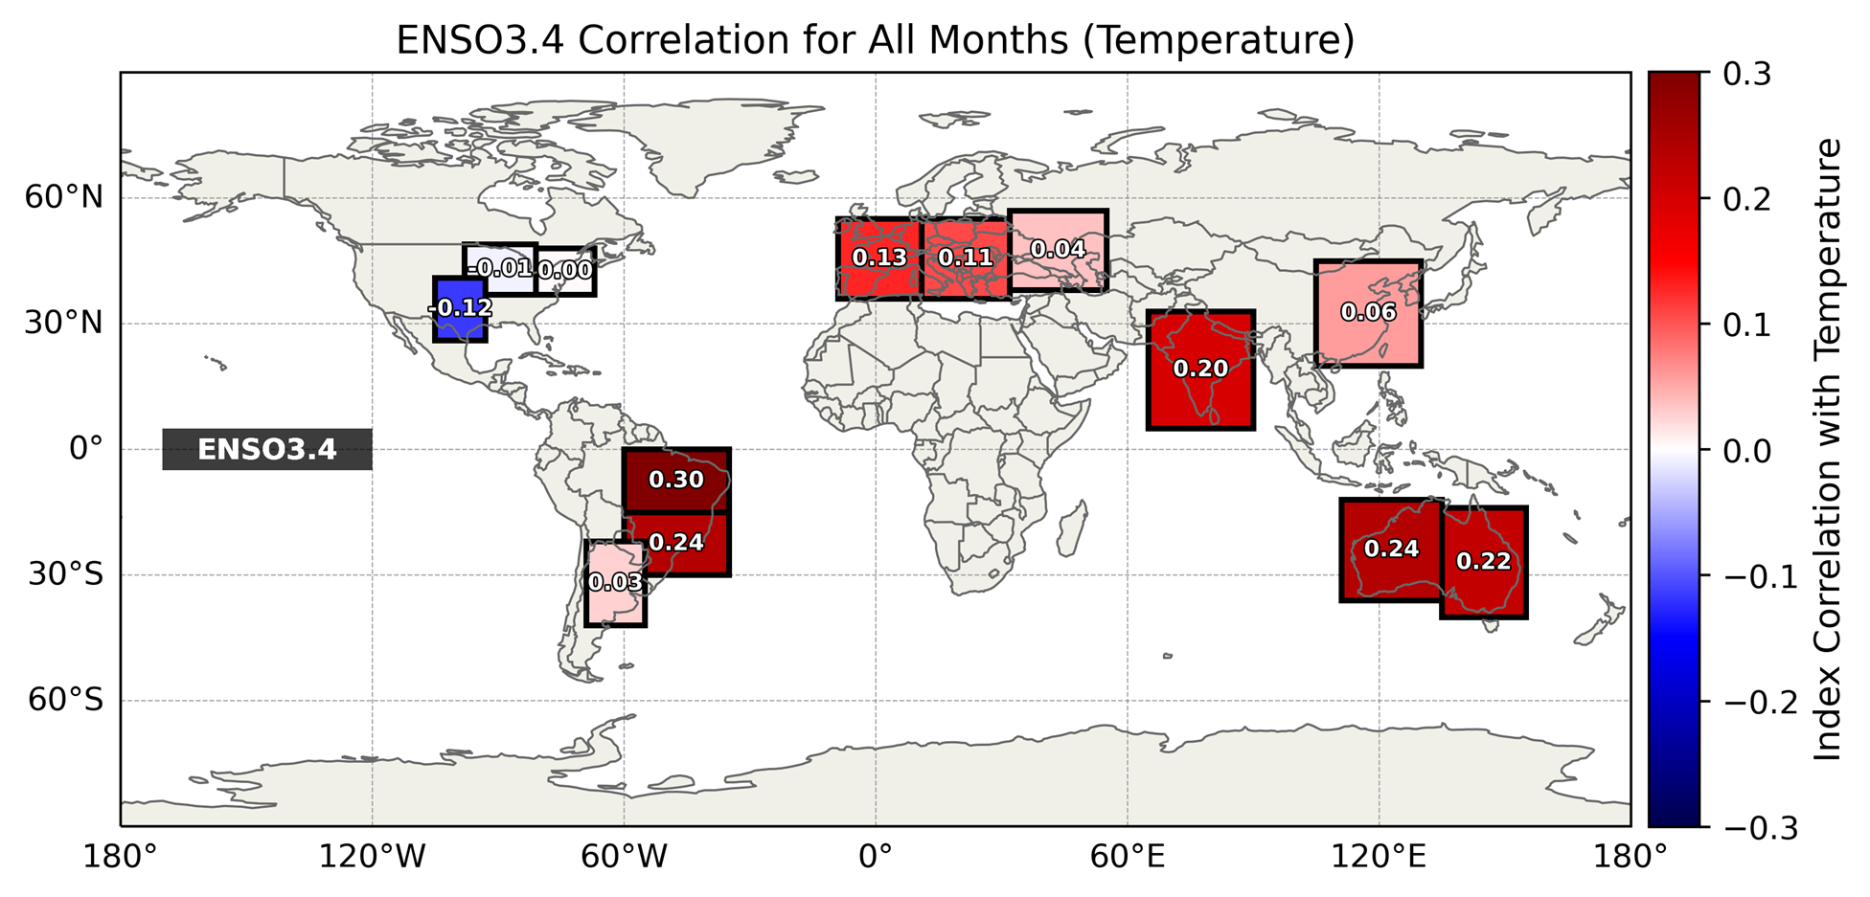
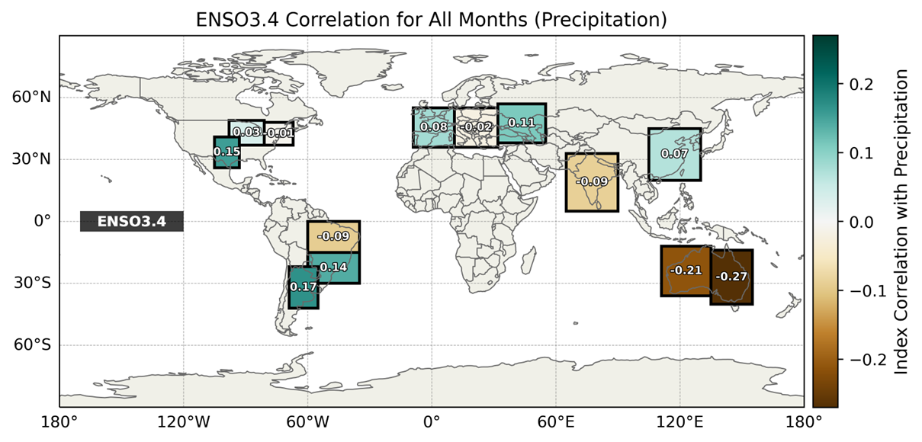

Slide 18
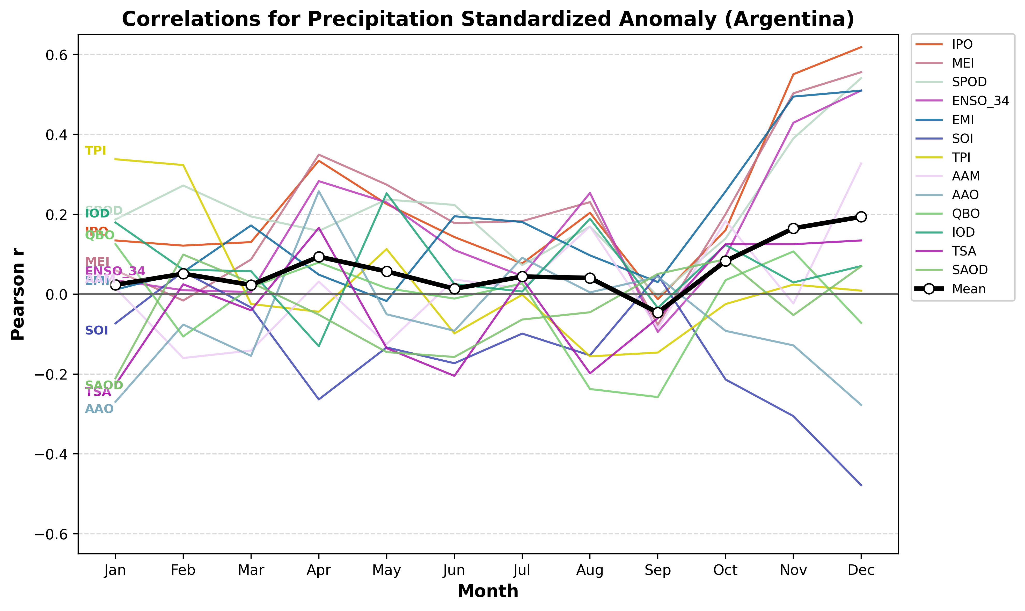

Slide 19
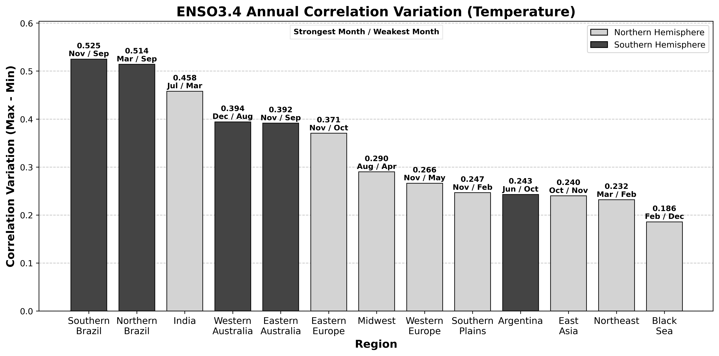

Slide 20
Expected Results
Model predictions will generally reflect the correlations that were found beforehand
Sign and magnitude
Potentially limited skill regarding intra-annual variability
Using a multiple regression model should still offer better results than a simple linear regression model
Output should include tercile-based categories and offer uncertainty metrics
Above/Below/Near average
Tercile probabilities

Slide 21
Future Work
Turning correlation analysis into an actionable model
Take forecasted indices and use the correlation trends to forecast temperature and precip. anomalies
Possible statistical approach (Multi-Linear Regression)
Well-established method of analyzing multiple predictive variables
Concerns about how it may handle intra-annual variability and probability
Possible ML approach
Could offer more insights and determine more accurate patterns
Limited by team's prior experience on the subject matter
Possible "Proxy Years" product
Attempt to match forecasted index values with the closest historical analog

Slide 22
References
AS, 2024: WLS. Amazonaws.com,. https://rstudio-pubs-static.s3.amazonaws.com/1248584_e57ba116e2fb4f97995987db27b7cc67.html (Accessed March 1, 2026).
Breusch, T. S., and A. R. Pagan, 1979: A Simple Test for Heteroscedasticity and Random Coefficient Variation. Econometrica, 47, 1287–1294, https://doi.org/10.2307/1911963.
González-Pérez, A., R. Álvarez-Esteban, A. Penas, and S. Del Río, 2022: Analysis of recent rainfall trends and links to teleconnection patterns in California (U.S.). Journal of Hydrology, 612, 128211, https://doi.org/10.1016/j.jhydrol.2022.128211.
Goodrich, G. B., and J. M. Walker, 2011: The Influence of the PDO on Winter Precipitation During High- and Low-Index ENSO Conditions in the Eastern United States. Physical Geography, 32, 295–312, https://doi.org/10.2747/0272-3646.32.4.295.

Slide 23
References
NASA Johnson Space Center, 2021: ISS064-E-48480.
Perktold, J., S. Seabold, J. Taylor, and statsmodels-developers, 2025: statsmodels. www.statsmodels.org,. https://www.statsmodels.org/stable/index.html.
Reid, A.-K., and N. Allum, 2019: Learn to Test for Heteroscedasticity in Stata With Data From the Canadian Fuel Consumption Report (2015). SAGE Publications, Ltd. https://doi.org/10.4135/9781526472601
Zhang, N., T. B. Pathak, L. E. Parker, and S. M. Ostoja, 2021: Impacts of large-scale teleconnection indices on chill accumulation for specialty crops in California. Science of The Total Environment, 791, 148025, https://doi.org/10.1016/j.scitotenv.2021.148025.

